Slide 1

Sign Language Recognition and Translator
Group members:
Pooja Sharma (20104090) Nainisha Sharma (20104042) Disha Bendale (21204011)
Project Guide
Prof. Sonal Balpande

Slide 2
Contents
Introduction
Objectives
Scope
Literature Survey
Proposed System
Project Outcomes
Block Diagram
Use Case/DFD
Technology Stack
Suggestions in Review-1
Result and Discussion
Conclusion and Future Scope
References

Slide 3
1. Introduction
Sign language is used to communicate with deaf and mute people when vocal language is impossible.
Problem Identified:
Many people don't know how to use sign language, which can lead to miscommunication when communicating with someone who is deaf or mute.
Solution Proposed:
We proposed a system to recognize hand gestures and help users practice sign language. It can also be used to convert text messages into sign language, making it easier to communicate with those who don't understand sign language.

Slide 4
2. Objectives
To create a beginner-friendly model for sign language detection.
To aid in communication for those who have hearing impairment.
To make it easier for people with autism spectrum disorder (ASD) to communicate.
To offer a platform for those interested in sign language.

Slide 5
3. Scope
Create a more accurate model, improve the dataset.
By exposing the model to more accurate data during training, prediction accuracy can be increased.
By including additional sign languages, such as American Sign Language, among others.
To increase the ability to recognize more language through speech or text.

Slide 6
4. Literature Survey
Sr.no | Title | Author(s) | Year | Outcomes | Methodology | Result
1. | Indian Sign Language to Speech Conversion Using Convolutional Neural Network | Shashidhar R, Surendra R Hegde, Chinmaya K, Ankit Priyesh, A S Manjunath and Arunakumari B. N. | 2022 | The system recognizes Indian Sign Language (ISL) and translates it into text using Google's text-to-speech API, achieving a high accuracy of 99% in recognizing 4972 static hand signs for the 24 different English alphabets in ISL. | The study's technique entailed gathering static hand sign photos in (ISL) for each of the 24 distinct English alphabets, then preprocessing the data to remove background noise and other distractions. The recognized hand signals were translated into text using Google's text-to-speech API, facilitating communication between signers and non-signers. | The proposed method achieved a high accuracy of 99% in recognizing 4972 static hand signs for the 24 different English alphabets in Indian Sign Language (ISL).By using Google's text-to-speech API, they successfully translated sign language into text, facilitating communication between signers and non-signers.

Slide 7
4. Literature Survey
Sr.no | Title | Author(s) | Year | Outcomes | Methodology | Result
2. | Speech-to-Sign Language Translation for Indian Languages | Jashwanth Peguda, V Sai Sriharsha Santosh, Y Vijayalata, Ashlin Deepa R N and Vaddi Mounish | 2022 | The proposed system provides an accurate and efficient approach to converting speech to Indian Sign Language for six Indian regional languages and leads to better results. | The proposed system used techniques such as Speech Recognition, Discrete Wavelet Transformation, MFCC, GMM, LSTM, and Direct Translation to convert speech to Indian Sign Language for six Indian regional languages. | The proposed system provides an accurate and efficient approach to converting speech to Indian Sign Language for six Indian regional languages.The proposed system can be useful in enhancing communication between deaf or mute people and others, improving their quality of life.

Slide 8
4. Literature Survey
Sr.no | Title | Author(s) | Year | Outcomes | Methodology | Result
3. | Audio to Sign Language Translator Web Application | Anju Yadav, Rahul Saxena, Bhavna Saini, Vivek K Verma, and Vibhav Srivastava | 2022 | The system includes a parser element that converts incoming speech data or English text to a phrase structure grammar representation, which is then used by another module that contains the Indian sign language grammatical format. | The system uses a parser element to convert incoming speech data or English text to a phrase structure grammar representation and another module that contains the Indian sign language grammatical format to translate the English text into Indian Sign Language. | The system's video converter components and substitution and lexicon-based interfaces accurately represent ISL sentences in video film format. It can be useful in enhancing communication between deaf or mute people and others, improving their quality of life.

Slide 9
5. Proposed System
The proposed system have two main features which are as follows:
Sign language recognition:
The feature will allow the user to understand what sign language they are making and can be used to learn sign language gestures. The feature can be use to communicate with someone who only knows sign language.
Text to Sign language translation:
This feature allows users to learn sign language simply by writing to the system, and the system translates them into sign language. This feature can be useful to communicate with someone who is unable to communicate.

Slide 10
6. Outcome of Project
User can communicate through sign language
User can recognize sign language using our system.
User can know what the other person is telling through their sign language
User can translate their text into sign language.

Slide 11
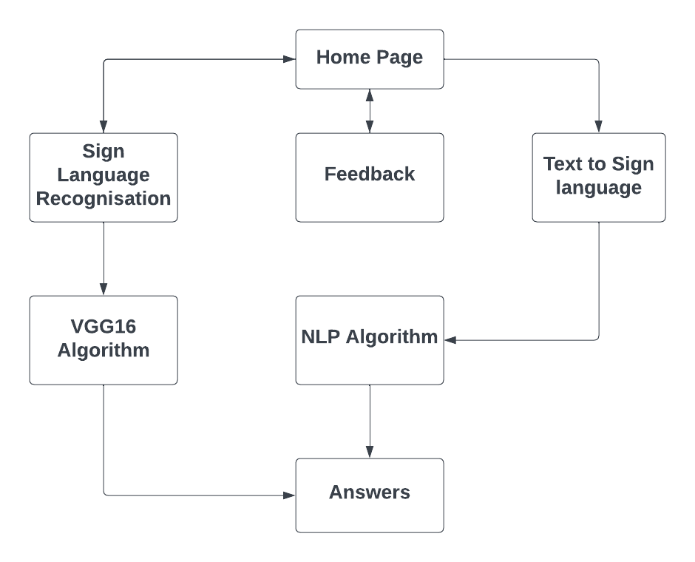
7. Block Diagram

Slide 12
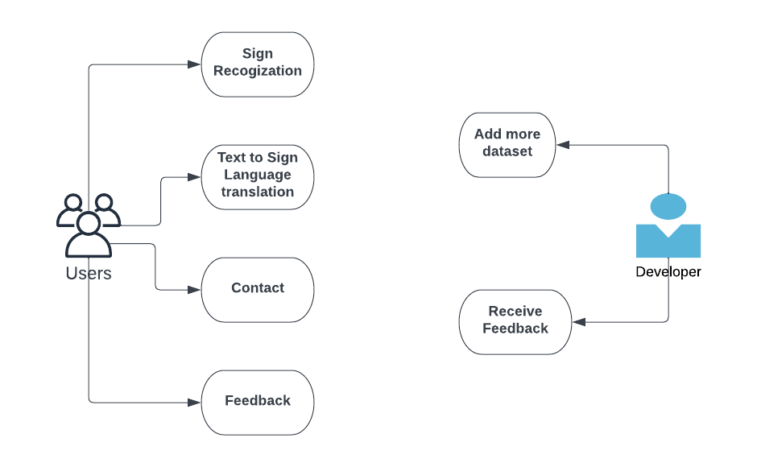
8. Use Case/Data Flow Diagram

Slide 13
9. Technology Stack
Front End:
Html, CSS, JavaScript
Back End:
Python
Algorithm:
VGG16, NLP

Slide 14
10. Suggestions in Review-1
According to the feedback received in Review 1, the suggestions were to modify the CNN algorithm and develop a custom dataset for better accuracy and address the limitations of the existing model.

Slide 15
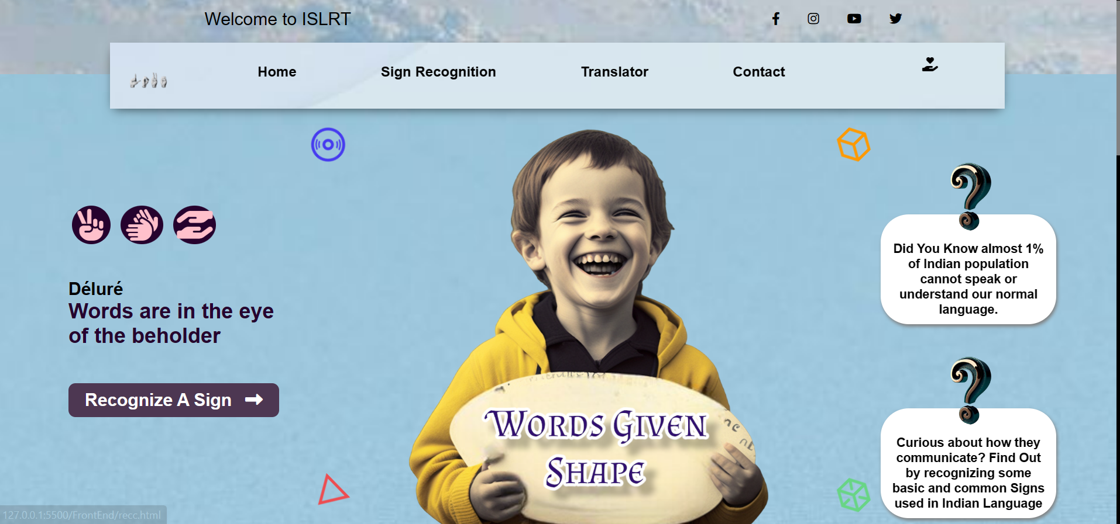
11. Result and Discussion
Fig1: Home Page

Slide 16
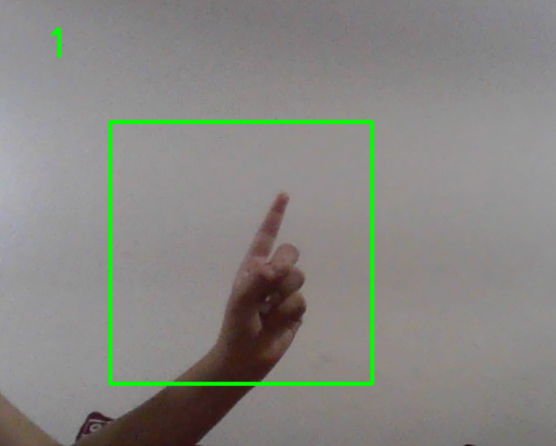
11. Result and Discussion
Fig2: Recognizing the number

Slide 17
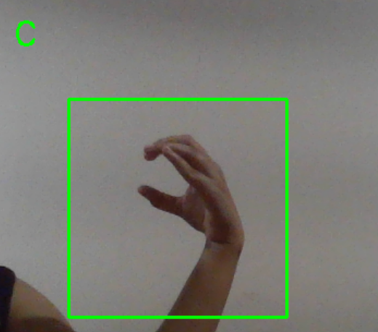
11. Result and Discussion
Fig3: Recognizing the alphabet

Slide 18
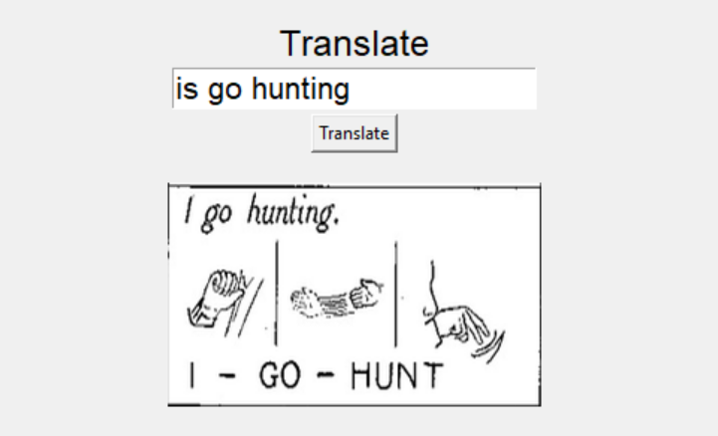
11. Result and Discussion
Fig4: Translate Text into ISL

Slide 19
12. Conclusion
In conclusion, the two initiatives described in our project, one utilizing VGG16 for ISL identification and the other utilizing NLP to translate text to ISL, demonstrate potential approaches for enhancing accessibility and communication for those who are deaf or mute.
With additional data and sophisticated algorithms, the VGG16 model can recognize ISL motions with even higher accuracy. The NLP study has shown excellent promise for precisely forecasting ISL motions that correlate to text inputs.
Future studies should, however, address issues like the dearth of a standardized ISL gesture lexicon and the quantity and quality of training data. The project can precisely anticipate the ISL motions associated with a given text by utilizing NLP and machine learning approaches.

Slide 20
13. Future Scope
The future scope of the project includes several potential avenues for improvement and expansion. Firstly, the system can be further enhanced by incorporating more advanced algorithms for better accuracy and robustness. Additionally, the system can be expanded to cover a wider range of sign languages and dialects.
Furthermore, the project can be transformed into an online free course to educate individuals on sign language recognition and translation.
Moreover, the project can be integrated with mobile applications to enable easy access and usage by a wider audience.
Overall, the future scope of the project is vast and offers numerous possibilities for advancement, education, and societal impact.

Slide 21
10. Reference
A. Yadav, R. Saxena, B. Saini, V. K. Verma and V. Srivastava, "Audio to Sign Language Translator Web Application," 2021 International Conference on Computational Performance Evaluation (ComPE), Shillong, India, 2021, pp. 321-326, doi: 10.1109/ComPE53109.2021.9751857.
J. Peguda, V. S. S. Santosh, Y. Vijayalata, A. D. R. N and V. Mounish, "Speech to Sign Language Translation for Indian Languages," 2022 8th International Conference on Advanced Computing and Communication Systems (ICACCS), Coimbatore, India, 2022, pp. 1131-1135, doi: 10.1109/ICACCS54159.2022.9784996.
S. R, S. R. Hegde, C. K, A. Priyesh, A. S. Manjunath and B. N. Arunakumari, "Indian Sign Language to Speech Conversion Using Convolutional Neural Network," 2022 IEEE 2nd Mysore Sub Section International Conference (MysuruCon), Mysuru, India, 2022, pp. 1-5, doi: 10.1109/MysuruCon55714.2022.9972574.
Kodandaram, Satwik Ram & Kumar, N. & Gl, Sunil. (2021). Sign Language Recognition. Turkish Journal of Computer and Mathematics Education (TURCOMAT). 12. 994-1009.

Slide 22
Thank You...!!

